Slide 1

Modal verbs

Slide 2
Revision

Slide 3
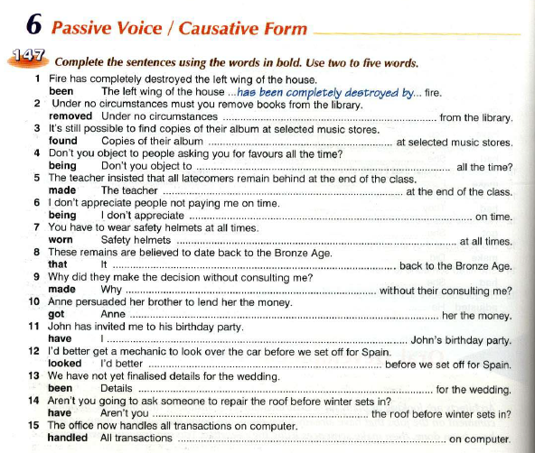

Slide 4
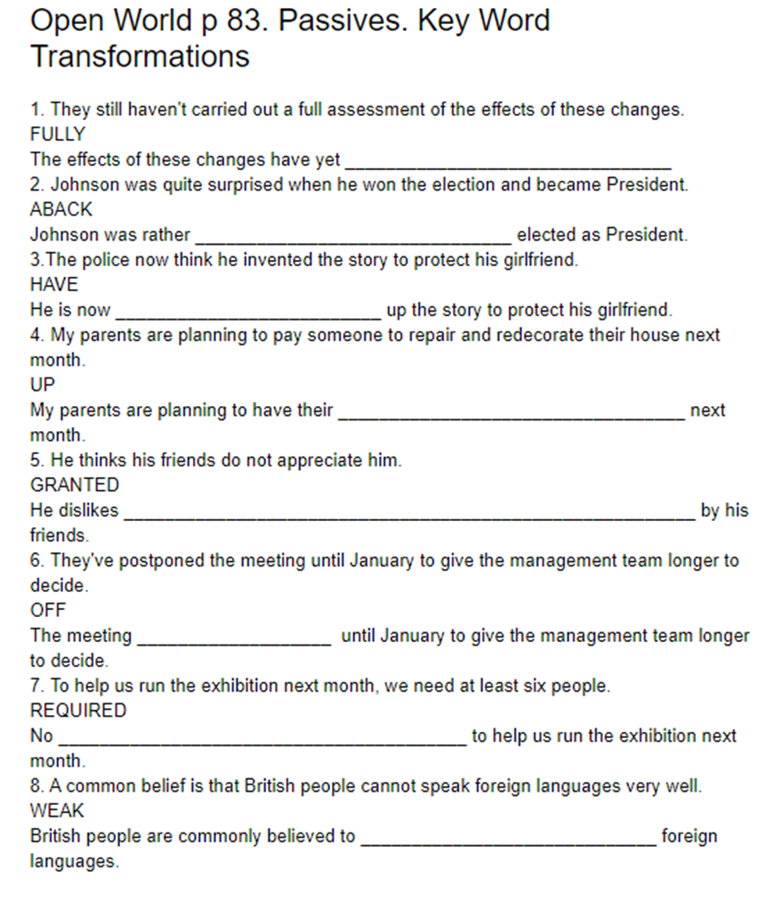

Slide 5
Modal verbs

Slide 6
Modal verbs meaning
Modal verbs of obligation, advice, permission, ability….
I must clean my room.
He can play tennis.
May I go now?
Modal verbs of deduction, probability
This movie must be good.
He might be at home.

Slide 7
Modal verbs of obligation, advice, permission, ability
Different tenses

Slide 9
I cannot swim.
Present Perfect.................................................................
Past Simple.................................................................
Past Perfect.................................................................
Future Simple.................................................................

Slide 10
They needn’t do it now.
Present Perfect.................................................................
Past Simple.................................................................
Past Perfect.................................................................
Future Simple.................................................................

Slide 11
He must help me
Present Perfect.................................................................
Past Simple.................................................................
Past Perfect.................................................................
Future Simple.............................................................

Slide 12
4. You mustn’t cheat.
Present Perfect.................................................................
Past Simple.................................................................
Past Perfect.................................................................
Future Simple.................................................................

Slide 13
Modals of probability

Slide 14
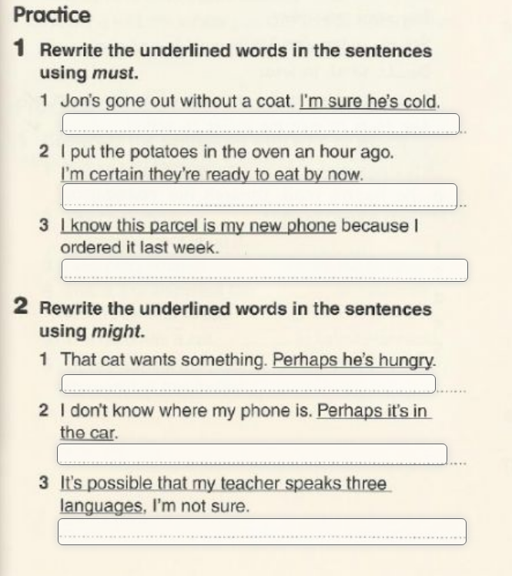
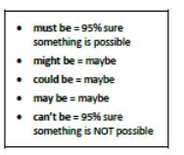

Slide 15
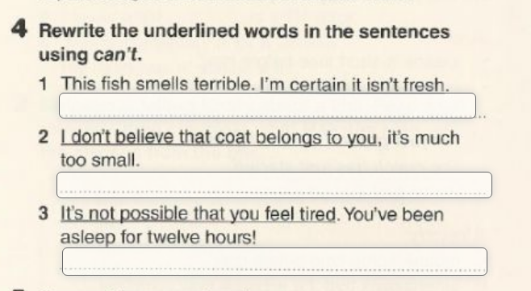

Slide 16
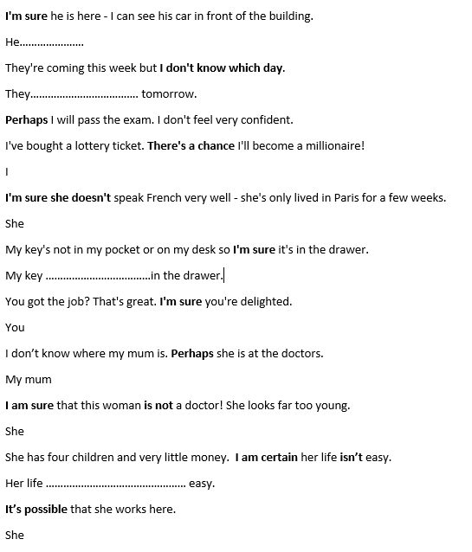

Slide 17
Past modals

Slide 18
W czasie przeszłym czasowniki modalne tworzą dwie formy: neutralną i zmodalizowaną – grupy zmodalizowane.
Po polsku nie ma różnicy między tymi formami, obydwie uzyskują takie samo tłumaczenie i dla rozróżnienia potrzebne jest podanie kontekstu lub odpowiednia intonacja. W języku angielskim różnica ta jest widoczna już na poziomie czasownika modalnego i jego formy, inne jest również znaczenie.
Formy neutralne używane są wtedy kiedy stwierdzamy fakt, nie mają żadnego zabarwienia i nie kryją w sobie dodatkowych znaczeń.
Grupy zmodalizowane używane są wtedy, kiedy mówimy o naszym przypuszczeniu, domyśle, wyrażamy prawdopodobieństwo, mówimy o czymś, co jest sprzeczne z oczekiwaniem.

Slide 19
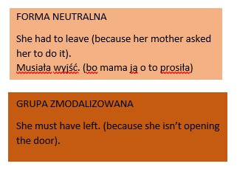

Slide 20
Tworzenie grup zmodalizowanych
MODAL VERB + HAVE + IIIf/ED

Slide 21
• MUST
Betty had to go to London (because her mother was ill).
grupa zmodalizowana - must have V-ed (III)
Betty must have gone to London (because she isn’t opening the door).
• CAN / COULD
Betty could (was able to, was allowed to) go to London (and she went).
grupa zmodalizowana - can’t have V-ed (III) - czasownik can występuje w grupie zmodalizowanej z przeczeniem, czasownik could występuje z przeczeniem i bez.)
Betty can’t have gone to London surely! (I really think she didn’t go).
Betty could have made it. (I think she could, but not necessarily.)
• SHOULD
W czasie przeszłym są zawsze w postaci grupy zmodalizowanej
Betty should have gone to London (but she didn’t).Betty powinna pojechać do Londynu (ale nie pojechała)
• MAY / MIGHT
It might snow so I didn’t go for a walk. Może padać śnieg, więc nie poszłam na spacer.
grupa zmodalizowana - may/might have V-ed/(III)
Betty may have gone to London (because I can’t see her today). Betty chyba wyjechała (bo nie widzę jej dzisiaj).

Slide 22
must + have + verb + ed / III f (95% sure)
1. He ran a marathon.
2. She witnessed a murder.
3. She lost my dog, but then it was found in my neighbour’s garden.
4. She isn’t opening the door.
5. My little sister was terrified.
6. I called you twice, but you didn’t answer.
might/could/may + have + verb + ed/ III f (50% sure)
1. They are gone.
2. Who did it? (Mike)
3. I don’t know where is your phone.
4. He didn’t have enough money to pay for the dinner.
5. I can’t find my wallet.
6. Where is my chocolate?
can’t / couldn’t + have + verb + ed/ III f (100% sure that something not happened)
1. He is innocent.
2. I heard that Suzy got caught shoplifting yesterday afternoon.
3. I think Steven drove to work today. But he doesn’t have a car.
4. His girlfriend cheated on him. (happy)
5. Do you suspect him of taking your bag? He was always by my side.
6. I saw your daughter in a pub last night. (she is grounded)

Slide 23
should/ shouldn’t + have + ed / III f
1. This meal is awful.
2. My friend is angry at me.
3. I was late for work today.
4. She is freezing!
5. It is raining and I am all wet.
6. There is no enough sugar for a cake.
Needn’t+ have+ ed/IIIf
1. He bought me a very expensive present.
2. You bought too much food.
3. Why did you come to work today?

Slide 24
Wyrażenia didn’t need to i didn’t have to mogą być stosowane wymiennie (nie ma między nimi żadnej różnicy w znaczeniu) i odnoszą się do braku w przeszłości konieczności wykonania jakiejś czynności.

Slide 25
didn’t have to do ( nie musiałem I nie zrobiłem) needn’t have done (zrobiłem ale niepotrzebnie)
I …….. anything special for the party. Wine would be fine. (bring) ( I brought an expensive present)
You ……….… for the test. It has just been cancelled. (prepare)
My parents … the car because they fixed the old one. (change)
Why didn’t you leave these papers in the office? You really …………….. them here. (bring)
You could have asked me for help. You ……….. all the work by yourself, but you did (do)
You ……………… here. I completed the task without your help. (come)
I really like your cooking but you …………… me so many dishes. I’m full up and can’t have any more bites. (serve)
We had everything we needed so they ………..… shopping. (go)

Slide 26
We are at the party. Our friends have bought a new, luxurious car.
(on musiał kosztować dużo pieniędzy) ->
I called my friend. He didn’t answer.
(on mógł był być zajęty) ->
He is innocent.
(on nie mógł był tego zrobić, to niemożliwe) ->
My girlfriend left me.
(powinienem być dla niej lepszy) ->
After the party my house is a mess.
(nie powinienem był robić tej imprezy) ->

Slide 27
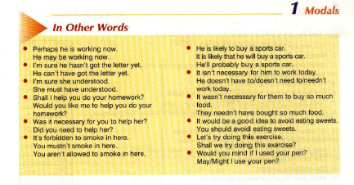
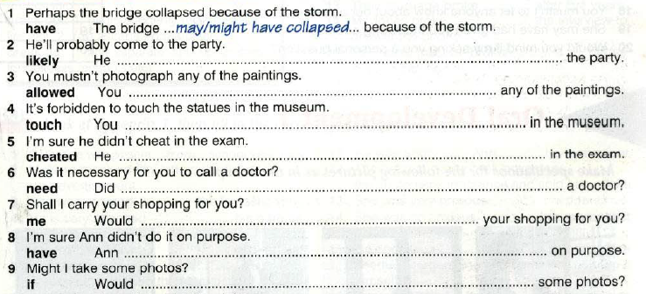

Slide 28
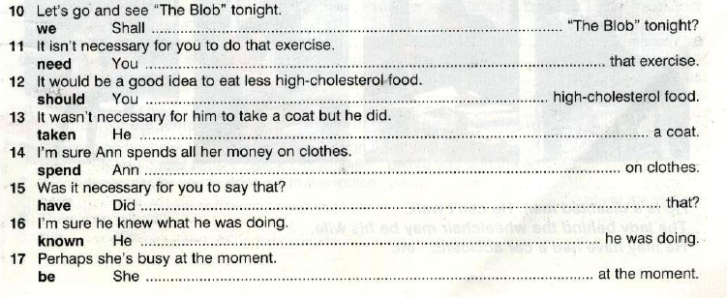

Slide 29
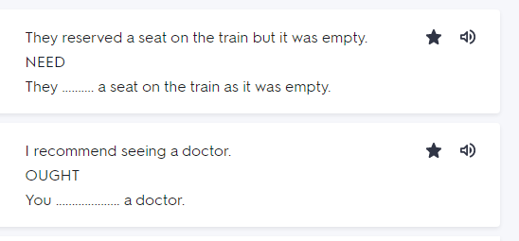
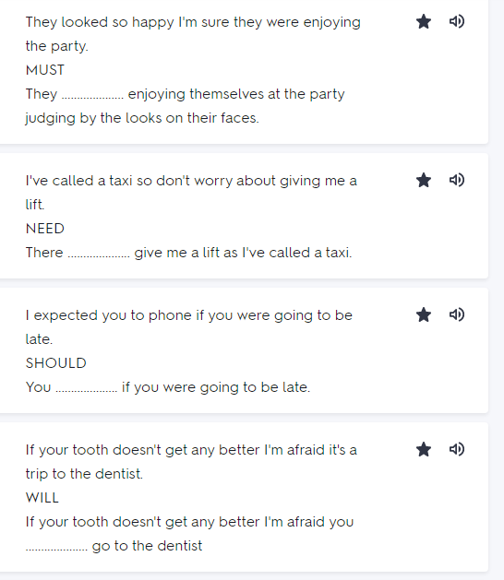

Slide 30
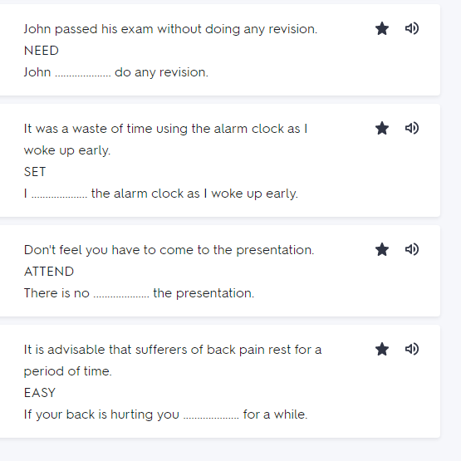

Slide 31
